Slide 1

Paper 3 :
Single molecule
tracking
CH-312 : Single molecule tracking paper W. Xiao, A.Simonato, Y. Kacem

Slide 2
Full title :
Single molecule tracking in
live cells reveals distinct target-search strategies of transcription factors
in the nucleus
Ignacio Izeddin 1, Vincent Récamier 1, Lana Bosanac 1, Ibrahim I Cissé 1, Lydia Boudarene 1, Claire Dugast-Darzacq 1, Florence Proux 1, Olivier Bénichou 2, Raphaël Voituriez 2, Olivier Bensaude 3, Maxime Dahan 4, Xavier Darzacq 1
Let’s go explore the nucleus !
CH-312 : Single molecule tracking paper W. Xiao, A.Simonato, Y. Kacem

Slide 3
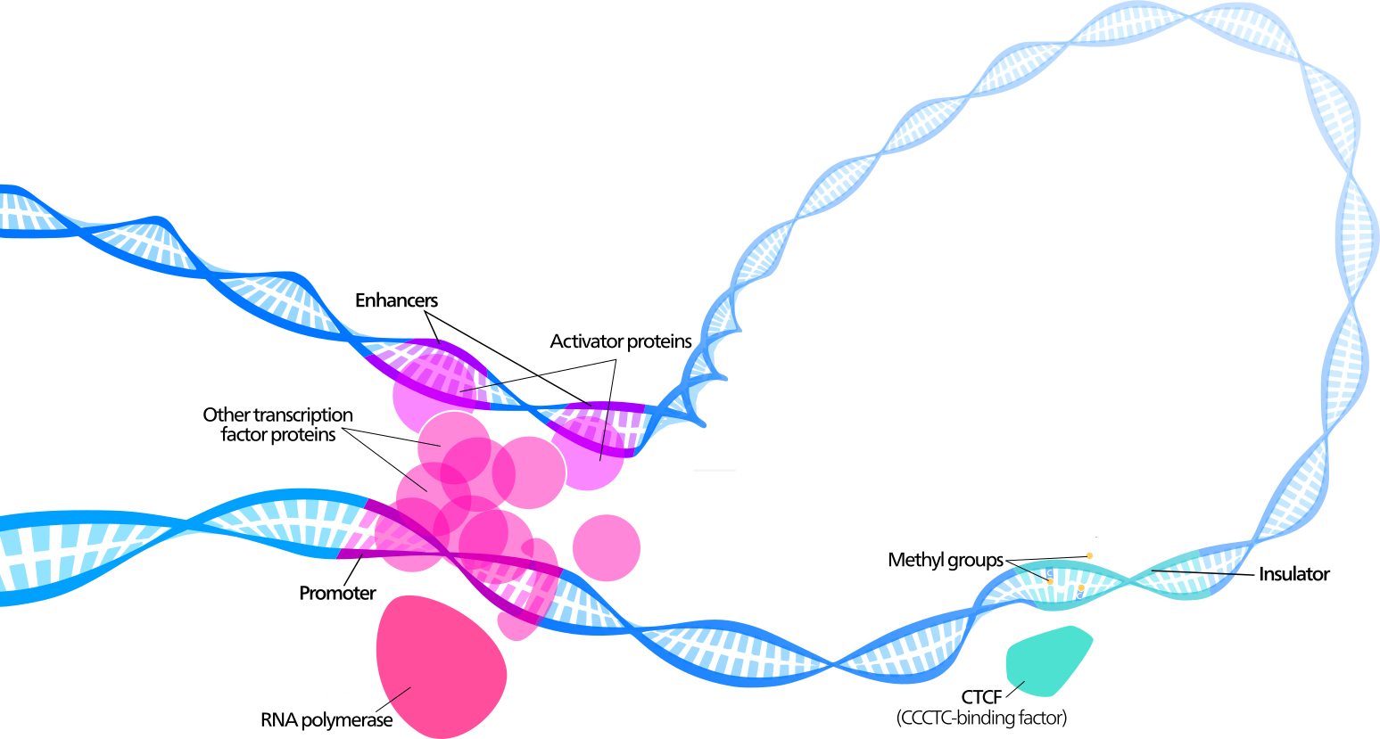
Definition : Transcription Factors (TF)
They are proteins that
bind to specific sequences
Those sequences are often found in the gene
promoter or enhancer regions
“Transcription switches and knobs”
= dictates which proteins a cell produces at given time
CH-312 : Single molecule tracking paper W. Xiao, A.Simonato, Y. Kacem

Slide 4
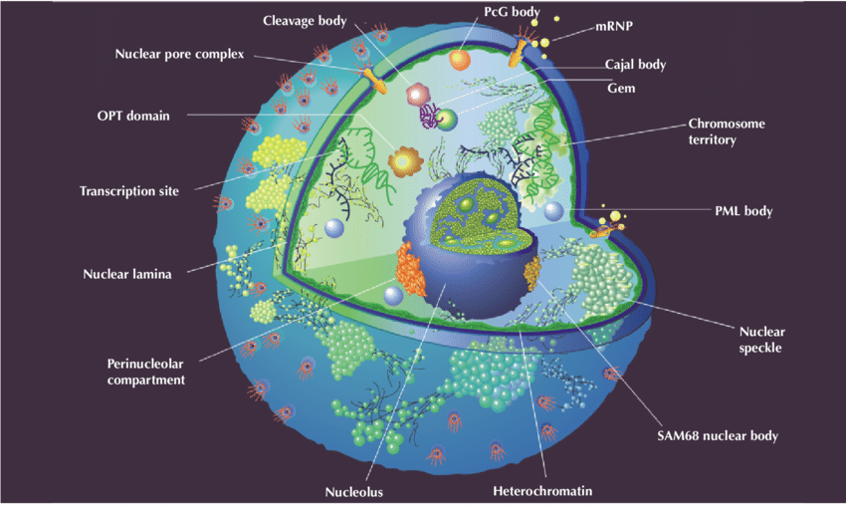
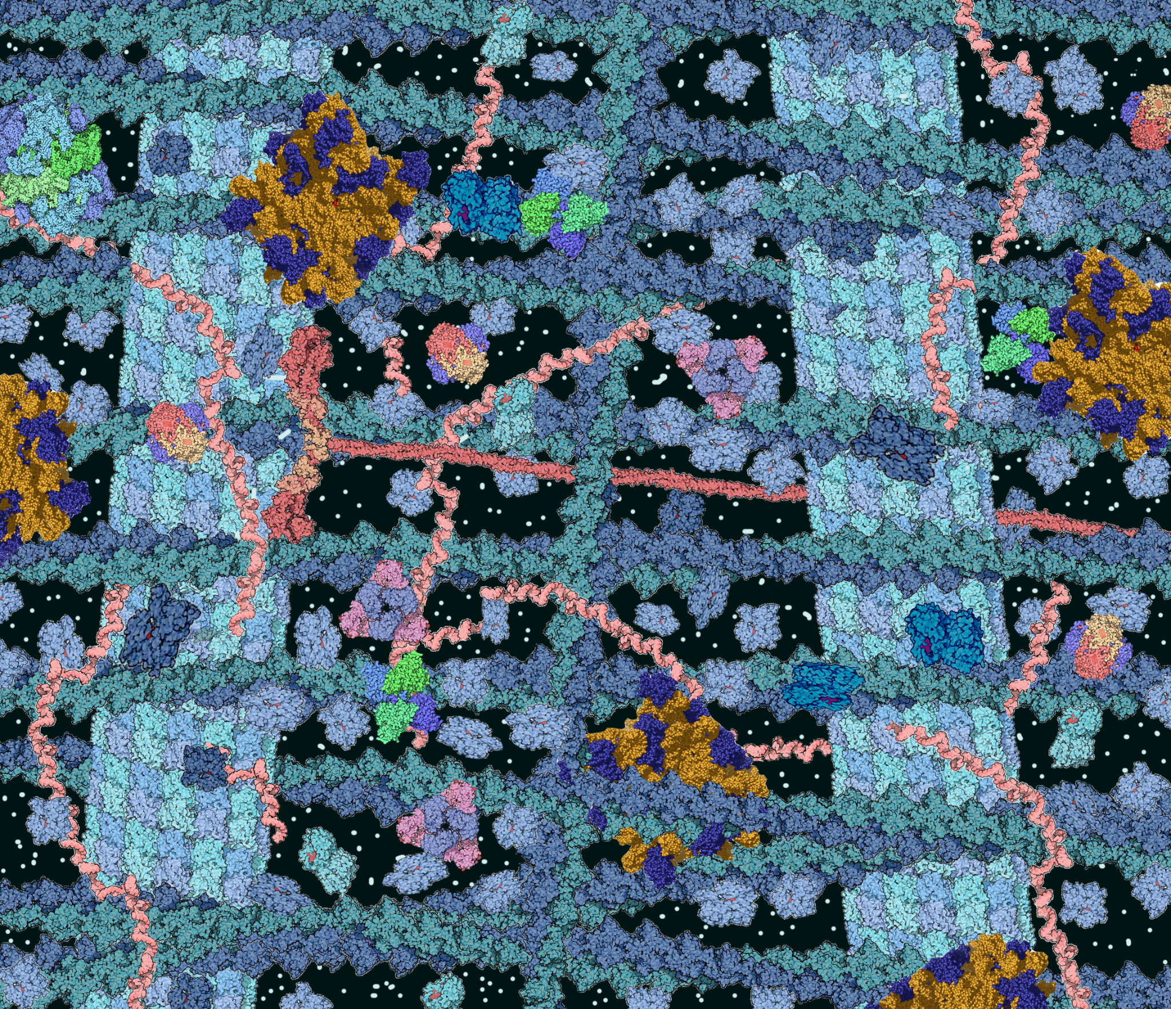
Definition : Nucleus of a cell
Biologically speaking : You already know !
Chemically speaking : The nucleus is a network of reactions spatially organized
Since the kinetics of a reaction
are largely determined
by the mobility characteristics…
How does the target-search of TFs work ?
CH-312 : Single molecule tracking paper W. Xiao, A.Simonato, Y. Kacem

Slide 5

Nuclear exploration : what we know
Much research has been done on how fast proteins diffuse in the nucleus
Nuclear crowding : can slow down diffusion
but also channel molecules towards target !
CH-312 : Single molecule tracking paper W. Xiao, A.Simonato, Y. Kacem

Slide 6
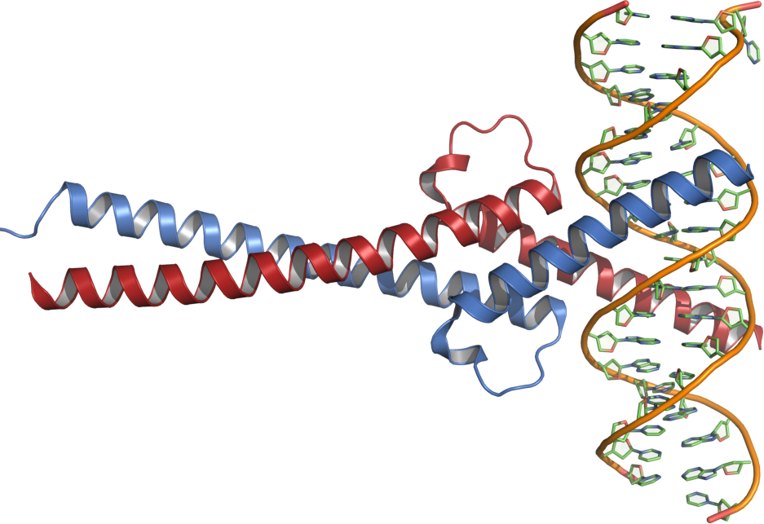
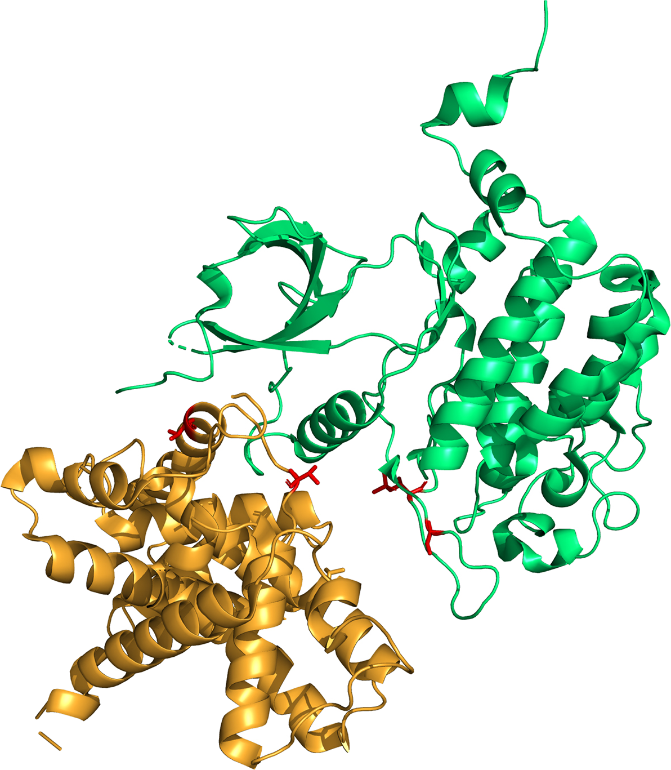
c-Myc and P-TEFb
Both of them bind to multiple sites !
c-Myc : proto-oncogene,
with DNA binding to E-boxes
P-TEFb : positive transcription
elongation factor, kinase dependent,
regulation driven by RNA polym II
CH-312 : Single molecule tracking paper W. Xiao, A.Simonato, Y. Kacem

Slide 7
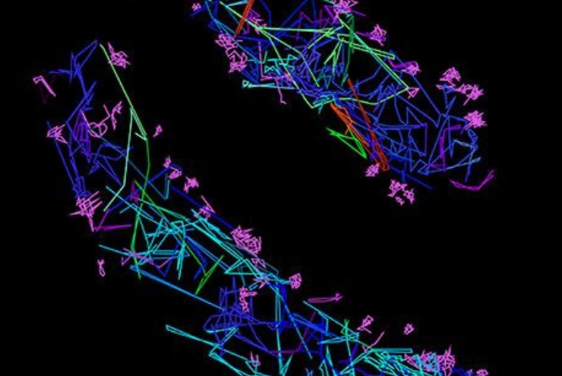
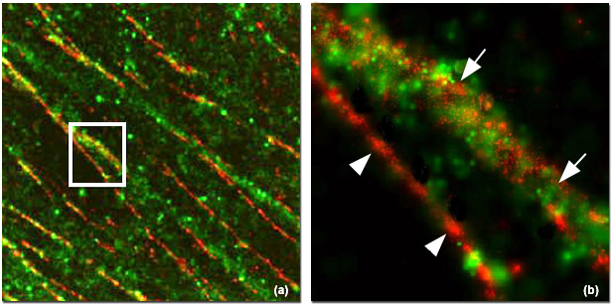
Method : SPT-PALM
PhotoActivated Localization Microscopy (PALM) allows to get high-density diffusion maps
Problem : “shutter speed”, limited
to slow proteins
→ New SPT-PALM that uses photoconvertible fluorophores and tilted illumination
Fluorophores that can be switched from dark to bright using a brief pulse of light
CH-312 : Single molecule tracking paper W. Xiao, A.Simonato, Y. Kacem

Slide 8
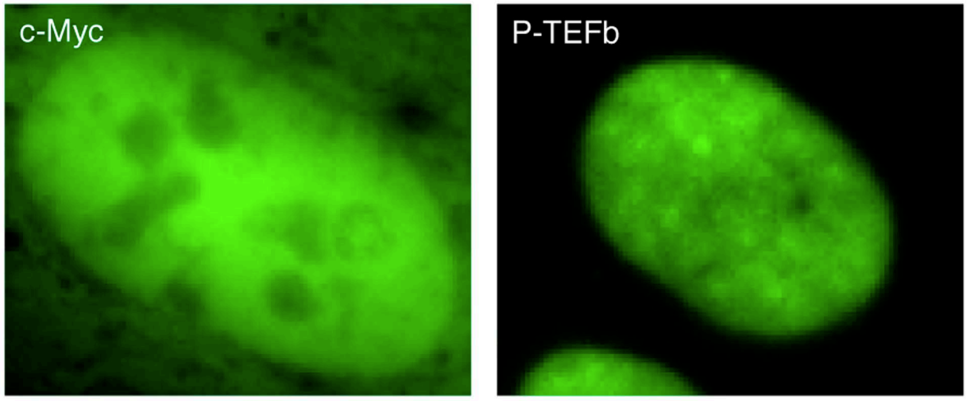
Method : new SPT-PALM
Cycles of activation :
1) a controlled pulse turns on a few chosen fluorophores
2) The high-speed camera captures the localized emission spots
3) Photobleaching to reset
They improved this process
→ reduced overlap
Improvement in activation protocol
Optimized photobleaching control
Advanced computational strategies
CH-312 : Single molecule tracking paper W. Xiao, A.Simonato, Y. Kacem

Slide 9
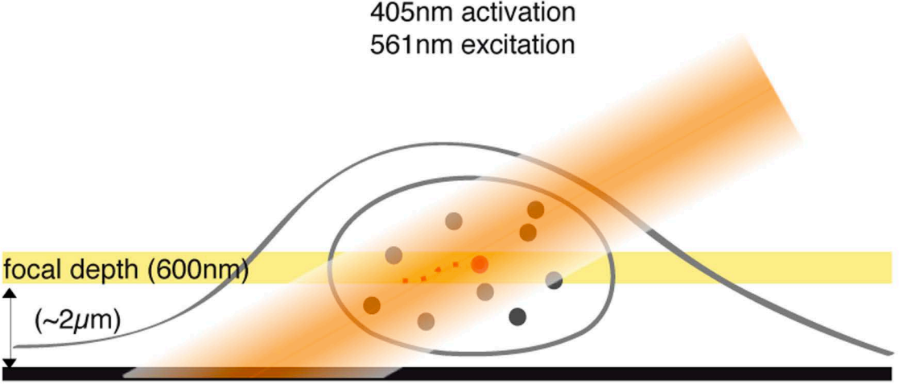
Method : new SPT-PALM
Proteins of interest were fused to
photoconvertible protein Dendra2
Fast acquisition with EMCCD camera
Tilted illumination which restricts the excitation volume
→ reduces background fluorescence from out of focus parts
Weak pulse of light to activate a small number of fluorescent molecules
An activation intensity around 0.01 kW/cm2 offered
the best trade-off between the number of detected particles and signal to noise ratio.
CH-312 : Single molecule tracking paper W. Xiao, A.Simonato, Y. Kacem

Slide 10
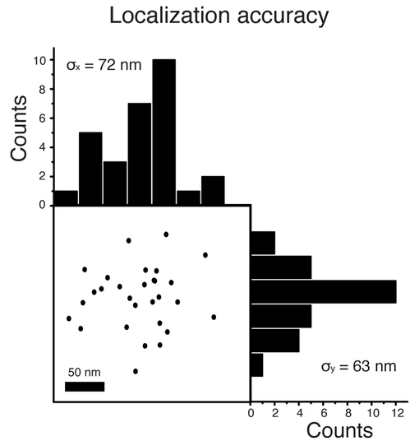
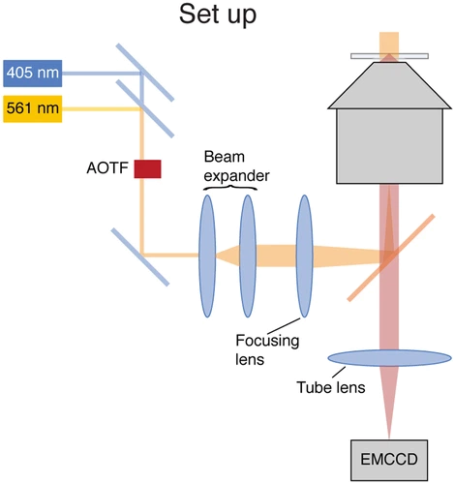
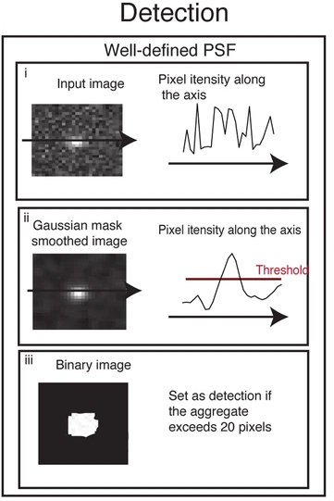
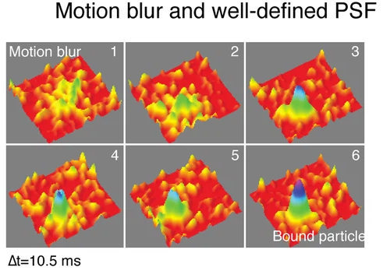
Method : new SPT-PALM
CH-312 : Single molecule tracking paper W. Xiao, A.Simonato, Y. Kacem

Slide 11
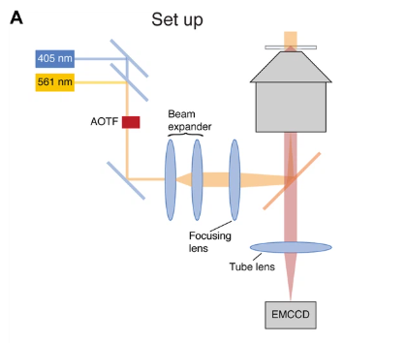
Single-molecule imaging:
Microscope Configuration
Overview of the instrument and optical components
Fluorophore Excitation & Activation
Laser sources, wavelengths, intensities, and timing used to excite and photoactivate Dendra2
Excitation Geometry
Wide-field vs. inclined illumination and its impact on image quality and background reduction
CH-312 : Single molecule tracking paper W. Xiao, A.Simonato, Y. Kacem

Slide 12
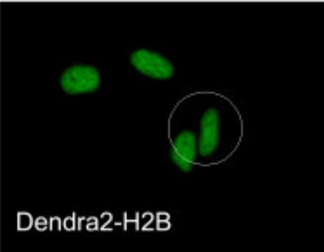
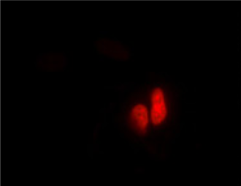
Single-molecule imaging:
Fluorescence Detection & Imaging
Camera setup, filters, acquisition speed, and spatial resolution
Pre-Conversion (Green Form) Imaging
Imaging of Dendra2 prior to activation using mercury lamp and appropriate filters
Image Acquisition Strategy
Frame rate, number of frames, activation intervals, and region of interest (ROI) selection
CH-312 : Single molecule tracking paper W. Xiao, A.Simonato, Y. Kacem

Slide 13
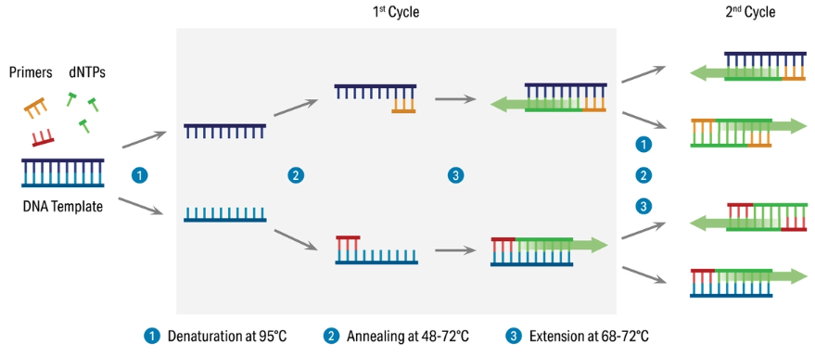
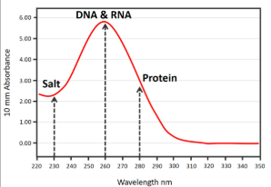
mRNA Expression & c-Myc Amplification Analysis
Experimental Conditions
Compared wild-type U2OS vs c-Myc–Dendra2-transfected U2OS
Equal cell numbers ensured via FACS sorting
Quantitative Real-Time PCR
Performed with SYBR Green qPCR mix on LightCycler 480
Used 1:20 diluted cDNA
Cycling: 45 cycles + melting curve analysis
Primers from Dugast-Darzacq & Grange (2009)
CH-312 : Single molecule tracking paper W. Xiao, A.Simonato, Y. Kacem

Slide 14
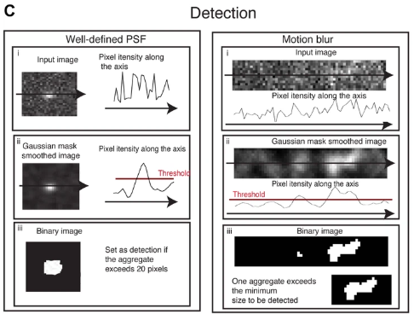
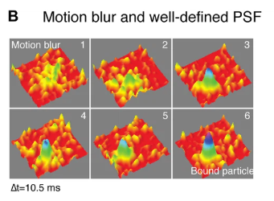
Detection and tracking of single-molecule
Chosen Approach
Moderate laser power (~4 kW/cm²)
Longer exposure (10 ms) aligned with camera speed
Accepts some blur, offset by better analysis
Step-by-Step Pipeline
Background subtraction (median over time)
Gaussian smoothing (σ = 121 nm)
Top 20% brightest pixels selected
Filter out spots < 0.2 μm²
Cluster nearby detections (≤ 500 nm)
Position = center of mass of cluster
CH-312 : Single molecule tracking paper W. Xiao, A.Simonato, Y. Kacem

Slide 15
Tracking of individual molecules
Tracking Logic
A detection is linked across frames only if it moves within a radius R
If multiple detections fall within R: → Stop the track and start new ones
If one detection fits two tracks: → Discard and truncate both to avoid misconnection
Choosing the Radius R
Estimated the chance that two unrelated molecules are within RRR by chance
Tuned RRR to be:
Large enough for fast-moving molecules
Small enough to prevent misconnections
CH-312 : Single molecule tracking paper W. Xiao, A.Simonato, Y. Kacem

Slide 16



Maximum Tracking Radius & Misconnection Probability
False Connections W(R)
W_{i}(R): # of detections >5 s later within radius R
Total:
Total Connections C(R)
C_{i}(R): # of detections in next frame within R
Total:
Choosing Optimal Radius
For R>2μm, false links dominate
Therefore, set R=2μm for all tracking
Misconnection Probability at Extremities
CH-312 : Single molecule tracking paper W. Xiao, A.Simonato, Y. Kacem

Slide 17
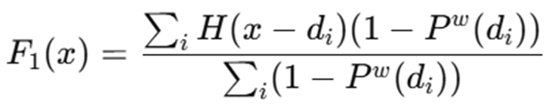


Cumulative Distribution Function (CDF)
The CDF
probability that a translocation step is shorter than a distance x
Theoretical CDF for Brownian Motion
CDF is a mixture of exponentials
CH-312 : Single molecule tracking paper W. Xiao, A.Simonato, Y. Kacem

Slide 18
Monte Carlo Simulations
Simulation Setup
10,000 trajectories, each with 500 steps
Performed on cubic and fractal lattices
Randomized starting positions
Goal: Analyze step-to-step angular distribution and its evolution over time
Lattice Bias
Cubic lattice → preferred angles (e.g., 90°) due to lattice geometry
This causes overrepresented directions in short time lags
Bias decreases with larger time lags
Normalized Angular Distribution
Final angular distributions were corrected by dividing each bin by the corresponding bin in the structural distribution
This removes lattice geometry bias
Verified that structural bias flattens at higher time lags
CH-312 : Single molecule tracking paper W. Xiao, A.Simonato, Y. Kacem

Slide 19
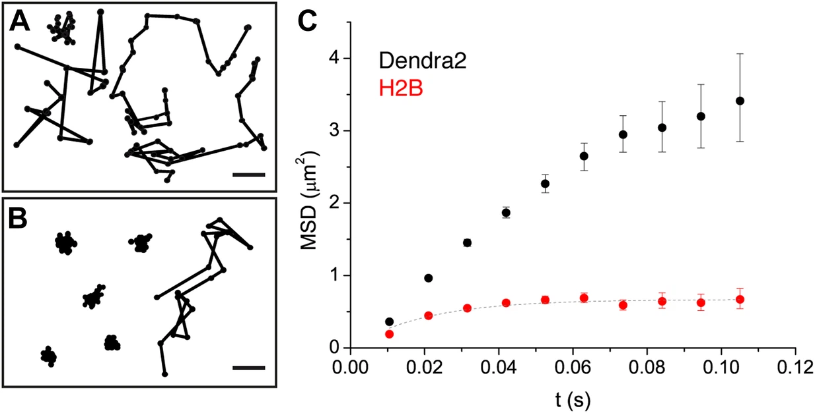
‘Free’ Dendra2 v.s. histone-bound Dendra2
They considered ‘free’ Dendra2 as a model for freely diffusing particles → assess whether the system can capture fast diffusion
Verify that for the 2 limit
cases the system produces
reliable outputs
CH-312 : Single molecule tracking paper W. Xiao, A.Simonato, Y. Kacem

Slide 20
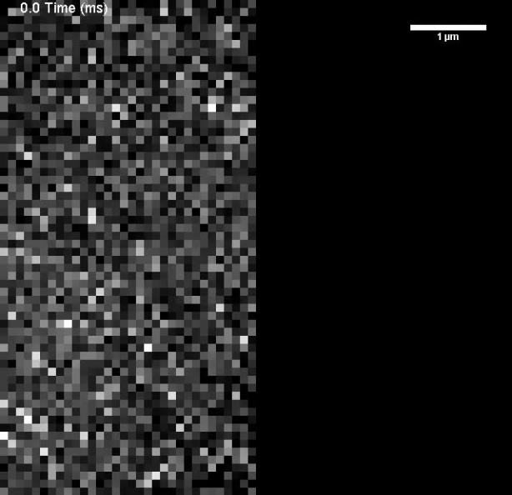
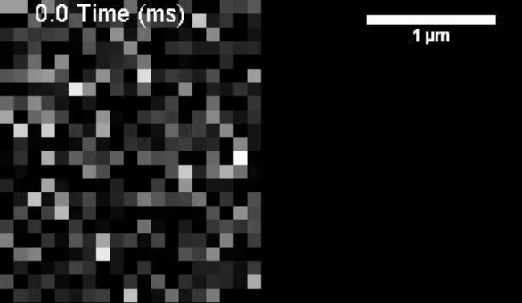
‘Free’ Dendra2 v.s. histone-bound Dendra2
Single trajectories formed by individual translocations recorded every 10 ms. 50% of the traces were reconstructed with more than four time points.
Localization accuracy of ∼70 nm
CH-312 : Single molecule tracking paper W. Xiao, A.Simonato, Y. Kacem

Slide 21
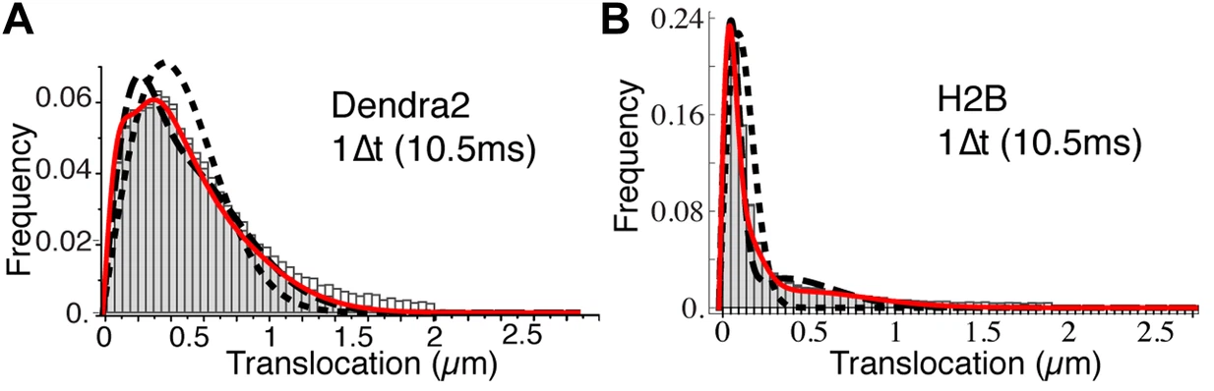
Population exclusion effect
Mean Square Displacement of free Dendra2 deviated from linear behavior of normal diffusion
Not all Dendra2 molecules behave identically !
“Population exclusion effect” : Faster molecules are more likely to move out of the focal plane.
The faster molecules drop out of the dataset and the slow ones remain
→ bias
CH-312 : Single molecule tracking paper W. Xiao, A.Simonato, Y. Kacem

Slide 22
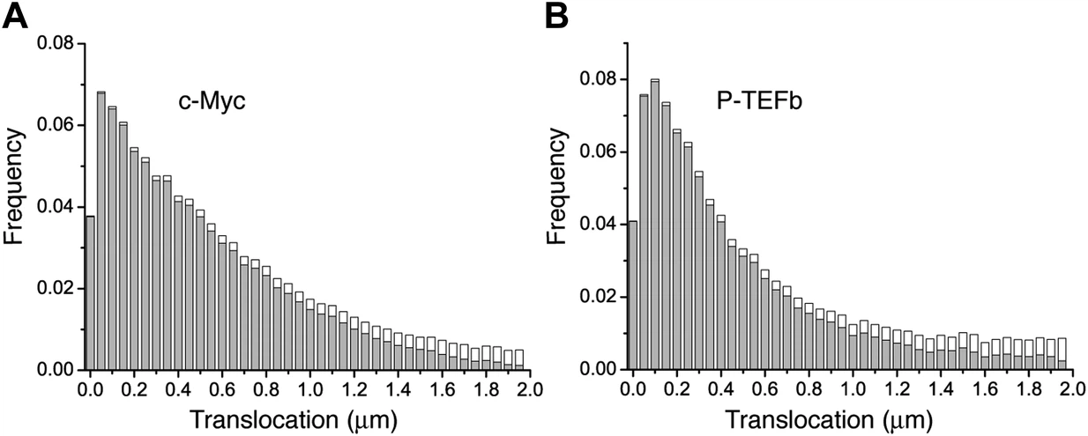
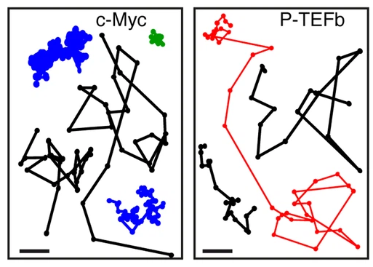
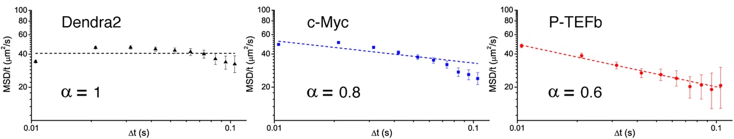
c-Myc and P-TEFb diffusion
Dendra2 was fused to c-Myc and to the Cyclin T1 subunit of P-TEFb
CH-312 : Single molecule tracking paper W. Xiao, A.Simonato, Y. Kacem

Slide 23

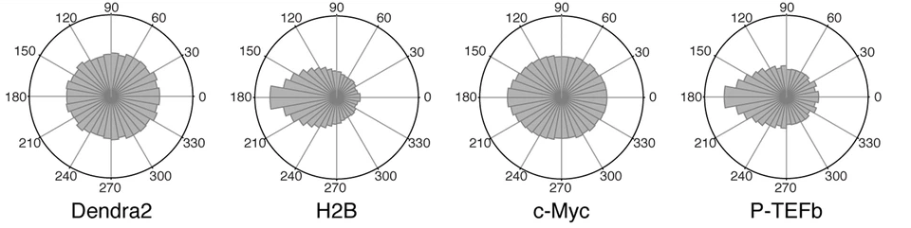
Asymmetric distribution of angles between consecutive translocations
This observable is very sensitive to the geometry of the exploration space
P-TEFb is significantly biased toward 180°: anti-correlation between two successive displacements
CH-312 : Single molecule tracking paper W. Xiao, A.Simonato, Y. Kacem

Slide 24
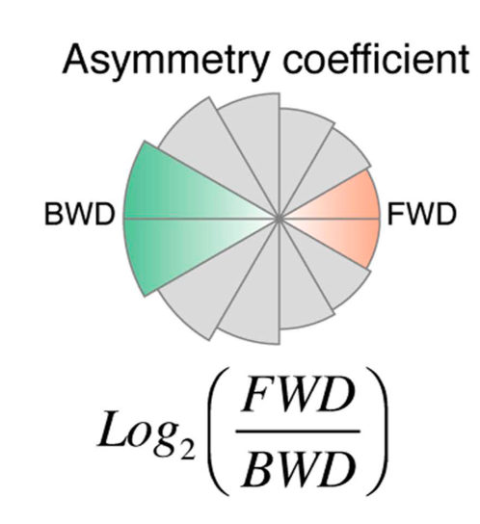
Temporal Evolution & Spatial Dependence of Angular Distribution
Asymmetry Coefficient (AC):
Compares forward (0°–30°) to backward (~180°) molecular movements
Negative AC — frequent turning back (antipersistent motion)
CH-312 : Single molecule tracking paper W. Xiao, A.Simonato, Y. Kacem

Slide 25
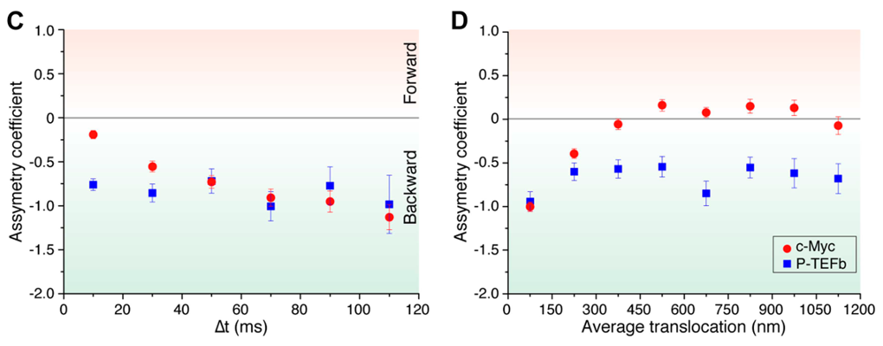
c-Myc:
• AC becomes more negative over time → increasing confinement
• AC ≈ 0 at larger translocations (>300 nm) → isotropic
P-TEFb:
• AC is consistently negative (both time and distance)
• P-TEFb moves through a scale-invariant, fractal-like environment
Summary:
• c-Myc: transiently confined but eventually escapes
• P-TEFb: constrained within a complex geometry at all scales
CH-312 : Single molecule tracking paper W. Xiao, A.Simonato, Y. Kacem

Slide 26
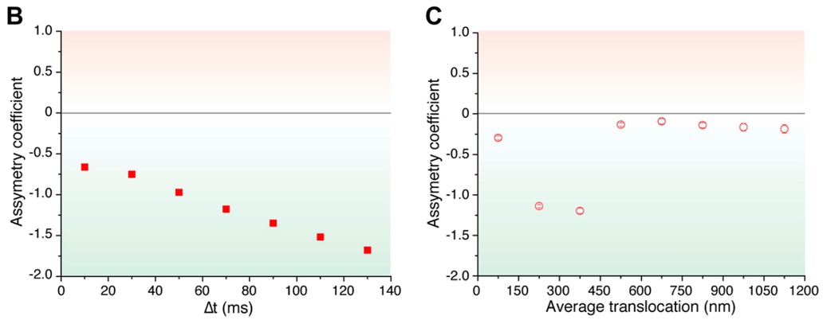
Numerical Simulations of Diffusion in Complex Media
• Numerical simulations: modelling diffusion behaviours
• Simple models:
• Intermittent diffusion and intermittent trapping:
• Matched c-Myc’s basic movement.
• Failed to capture strong “turning back” motion in P-TEFb.
• Combined model:
• Both slow down and be trapped: reproduces the trend observed in c-Myc.
CH-312 : Single molecule tracking paper W. Xiao, A.Simonato, Y. Kacem

Slide 27
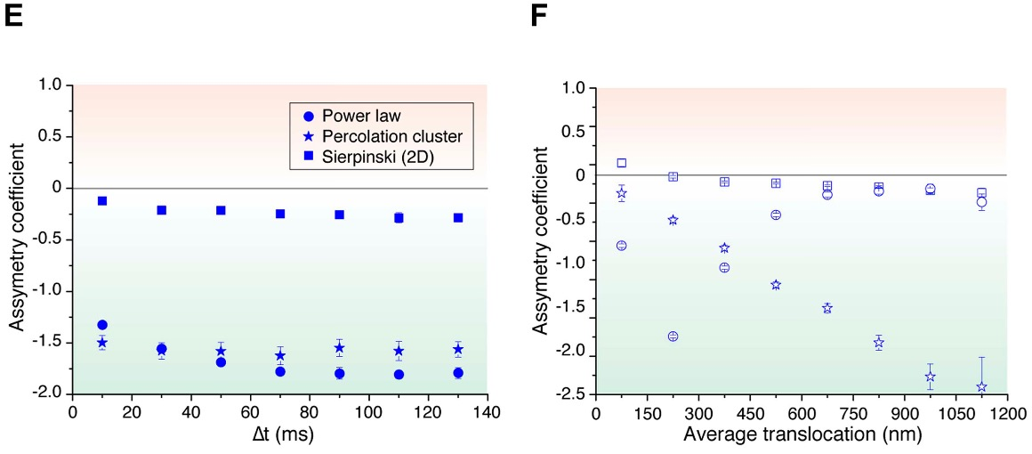
• Fractal Structures:
✘ 3D percolation cluster:
• AC decreased with distance → mismatch with data.
✔ 2D Sierpinski carpet:
• AC constant across scales → matches P-TEFb’s behaviour.
• Hierarchical Model:
• To explain P-TEFb’s motion (antipersistence)
• Distribution of trap sizes follow a power-law (Pareto distribution)
CH-312 : Single molecule tracking paper W. Xiao, A.Simonato, Y. Kacem

Slide 28
Search Strategies: Compact vs Non-Compact Exploration
• Df has an upper limit at Df = 3
• c-Myc, non-compact:
• Undergoes normal Brownian diffusion (Dw = 2)
• Dw < Df (more free, broad movement)
• P-TEFb, compact:
• Dw = 2/ α(0.6) = 3.3
• Dw > Df
• Dw = walk dimension
• Df = fractal dimension
Summary:
• c-Myc searches fast and wide
• P-TEFb searches slowly but carefully in one area.
CH-312 : Single molecule tracking paper W. Xiao, A.Simonato, Y. Kacem

Slide 29
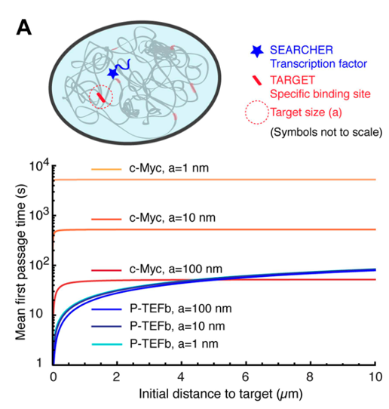
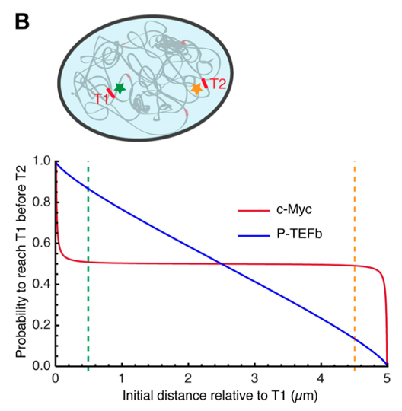
• c-Myc: MFPT increases steeply with distance → misses nearby targets →longer search times at short distances
• P-TEFb: MFPT grows slowly → finding nearby targets faster but taking longer to reach distant ones.
Splitting Probability (probability of a molecule to reach T1 before T2):
• c-Myc: ~50–50 chance of reaching either target.
• P-TEFb: strong bias toward nearest target → retains spatial memory.
CH-312 : Single molecule tracking paper W. Xiao, A.Simonato, Y. Kacem

Slide 30
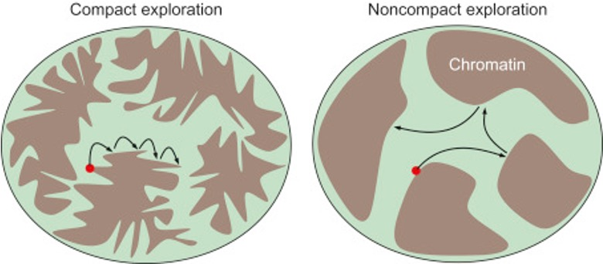
Discussion: Possible Mechanisms Behind Compact Exploration
• Why compact?
• Hypothesis 1 (unlikely):
• The nucleus divided into small connected areas (fractal maze), which limits movement.
• Hypothesis 2 (preferred):
• Dynamic binding with chromatin structures.
- Many weak, temporary interactions with
binding sites
• c-Myc: binds few sites → moves freely.
• P-TEFb: binds many sites (e.g. RNA Pol II CTD) → becomes confined
Summary:
• Compactness arises from interaction networks, not physical barriers.
CH-312 : Single molecule tracking paper W. Xiao, A.Simonato, Y. Kacem

Slide 31
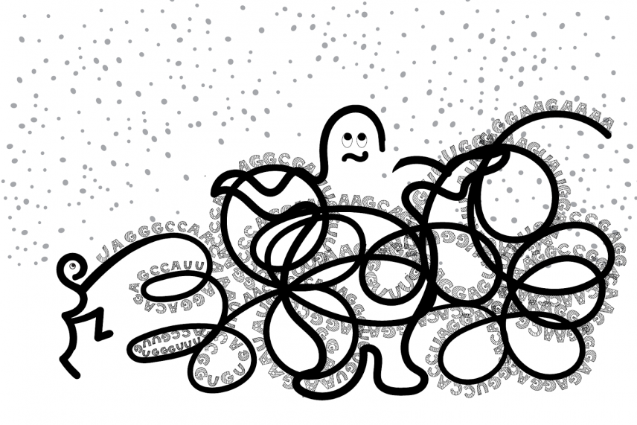
Discussion: TFs’ Mobility & Gene Regulation
Non-compact TFs (c-Myc):
• Broad, uniform exploration of the nucleus
• Equal access to all targets → uniform gene activation
• Less likely to revisit specific sites → no strong transcriptional bursts (lots of RNA made in a short time)
Compact TFs (P-TEFb):
• Repeatedly revisit local areas (recurrence) • Prefer nearby targets → spatially biased gene activity • Enable transcriptional bursting
CH-312 : Single molecule tracking paper W. Xiao, A.Simonato, Y. Kacem

Slide 32
Conclusion
Depending on proteins’ function: two main diffusion behaviours observed:
• Compact (e.g. P-TEFb): persistent local sampling.
• Non-compact (e.g. c-Myc): rapid, global scanning.
Functional consequences:
• Affects gene targeting, regulation timing, and expression stability.
Future questions:
• Can TFs switch between compact/non-compact?
• If yes, how is this switch controlled, and how does it affect gene activity?
Cells may regulate the degree of compactness (how confined or broad a TF moves), both in space and time, to better control gene expression.
CH-312 : Single molecule tracking paper W. Xiao, A.Simonato, Y. Kacem

Slide 33
Question 1 : Diffusion behaviors
How did the authors use the diffusion coefficients and trajectory analyses to distinguish between different search modes of the transcription factors ?
(Hint : don’t overthink)
CH-312 : Single molecule tracking paper W. Xiao, A.Simonato, Y. Kacem

Slide 34
Answer
Compute the mean squared displacement (MSD) for each trajectory.
Fit the trajectories to diffusion models yielded effective diffusion coefficients (D).
=> Fast diffusion (higher D values) is indicative of molecules moving unrestrained through the nucleoplasm, whereas slower diffusion (lower D values) points to molecular interactions that retard motion.
When transcription factors are not engaged in any binding interaction, they diffuse freely, resulting in higher diffusion coefficients. This is interpreted as the “scanning” phase where the molecule rapidly explores the nuclear volume.
CH-312 : Single molecule tracking paper W. Xiao, A.Simonato, Y. Kacem

Slide 35
Question 2 : Chromatin Environment Influence
What role does the chromatin landscape play in the target-search process of transcription factors as discussed in the paper ?
How did the nuclear environment influence transcription factor motion ?
(Hint : pause and ponder on the meaning of life)
CH-312 : Single molecule tracking paper W. Xiao, A.Simonato, Y. Kacem

Slide 36
Answer
In areas where chromatin is densely packed the movement of TFs is slow.
Dense chromatin offers many binding sites for TFs to interact with, which hinders their motion.
Fast-diffusing segments correlate with rapid scanning in open chromatin, whereas slow-diffusing segments correspond to transient binding.
CH-312 : Single molecule tracking paper W. Xiao, A.Simonato, Y. Kacem

Slide 37
Question 3 : Biophysical implications
How do the distinct target-search strategies contribute to the efficiency and specificity of gene regulation in live cells?
(Hint: Think about the ying and the yang)
(Hint: Ask the professor)
CH-312 : Single molecule tracking paper W. Xiao, A.Simonato, Y. Kacem

Slide 38
Answer
In a fast-diffusing state => the TF doesn't waste time lingering in unproductive regions.
Once a TF approaches regions of interest => it transiently slows down or “pauses.”
These slower diffusion periods correspond to nonspecific interactions that help the TF sample the local environment more thoroughly.
Optimize the trade-off between speed (finding targets fast)
and accuracy (avoiding wasted time on irrelevant sites).
CH-312 : Single molecule tracking paper W. Xiao, A.Simonato, Y. Kacem

